Slide 1
Different Ways to version Rest Api in Java
URL Versioning:
In this kind of versioning, we specify different url for different versions.
//Example of URL Versioning//
@GetMapping("v1/person")
public String personv1()
{
return new PersonV1().toString();
}
http://localhost:8080/v1/person
@GetMapping("v2/person")
public String personv2()
{
return new PersonV2().toString();
}
http://localhost:8080/v2/person

Slide 2
Parameterized Versioning
// Example of Parameterised versioning http://localhost:8080/person/param?version=1
@GetMapping(value="person/param",params ="version=1")
public String paramV1() {
return new PersonV1().toString();
}
http://localhost:8080/person/param?version=2
@GetMapping(value="person/param",params="version=2")
public String paramV2() {
return new PersonV2().toString();
}

Slide 3
Header Versioning
// Example of Header versioning
@GetMapping(value="person/header",headers="x-api-version=1")
public String headerV1() {
return new PersonV1().toString();
}
@GetMapping(value="person/header",headers="x-api-version=2")
public String headerV2() {
return new PersonV2().toString();
}

Slide 4
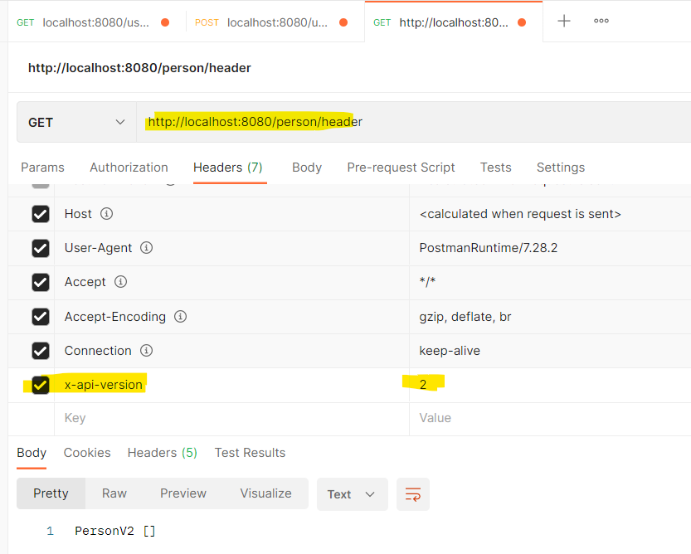
Header Versioning

